Slide 1
Standardization of Waterbox Utilization
For completion of MSDS692
Bryce Lakamp
March 3, 2023

Slide 2
Agenda
Introduction
Data Extraction
Cleaning
Exploration
Waterbox Combinations
Distributions
Correlations
Factor Reduction
Model development
Linear Regression
Support Vector Regression
Comparison
Determination of Optimal settings

Slide 3
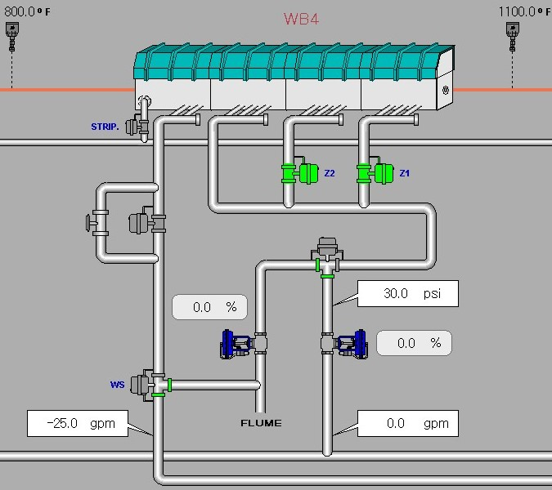
Introduction
In rod mill smooth material is produced from 0.219 to 0.750 inch in diameter
Hot steel mill use water to cool product to control for mechanical properties and dimensions
Five water cooling boxes (waterboxes) can be selected to control final temperature (LH) after final rolling (NTM)
Operator selects 0-5 boxes (in any combination) to achieve temperature
NTM
WB1
WB2
WB3
WB4
WB5
LH
– Nominal Diameter
– Temperature
– Speed
– Selected
– Valve Opening
– Pressure
– Flow
– Temperature

Slide 4
Data Extraction
Categorical factor data available in MS SQL Server Database
Continuous factor data available in separate MS SQL Server Database
Mechanical property and chemistry data available in Oracle Database
SQL queries for each table written
Some cleaning e.g. clustered index concatenation, whitespace trimming
Mechanical and chemistry data pulled from 4 tables and joined in SQL
Includes unions between tables of different structures
Includes aggregation of average chemistry
Save all as local raw backup
Remote
Local
Coil
– NTM
– WB
– LH
Py
SQLite
– NTM
– WB
– LH
– Properties
Tracking
– Schedule
– Coil
Oracle
– Chem1
– Chem2
– Mechanical1
– Mechanical2
SQLite
– Chemistry & Tensile

Slide 5
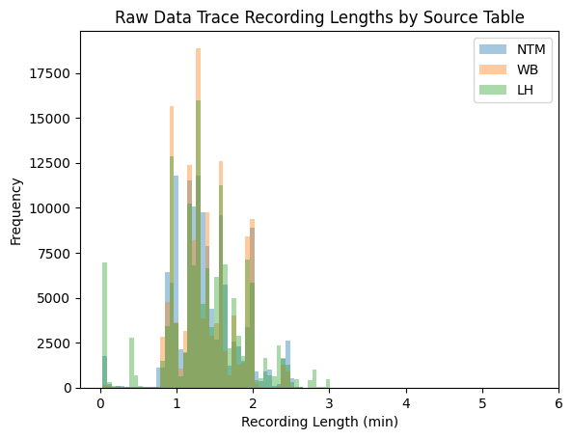
Cleaning
Removal of sensor artifacts (too small time periods)
Removal of duplicates
Index repeated due to recoding system error
Removal of null values
Removal of waterbox data when inactive
Sensor records characteristics, but doesn’t affect product
Removal of non-physically capable sensor readings

Slide 6
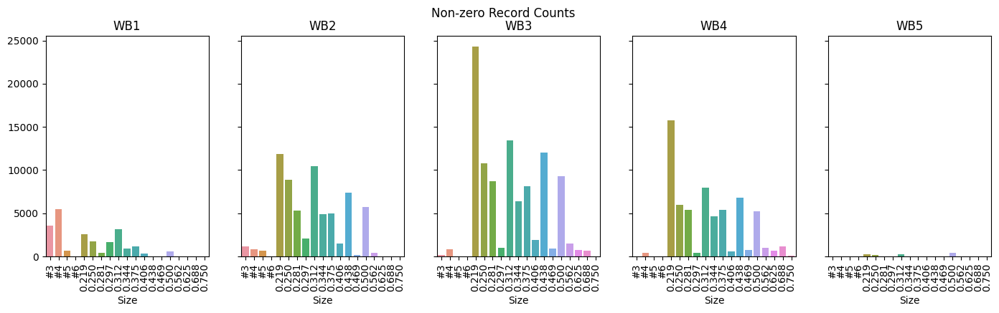
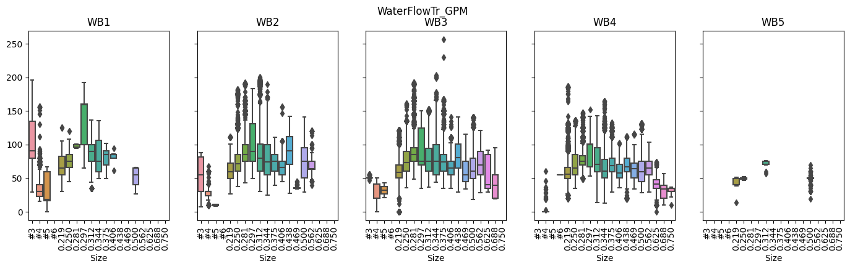
Exploration – Records, Distributions
Number of records by rod diameter
Classify different waterbox schemes based on combination of utilization
Distributions of factors, finding outliers and investigating for disposition

Slide 7
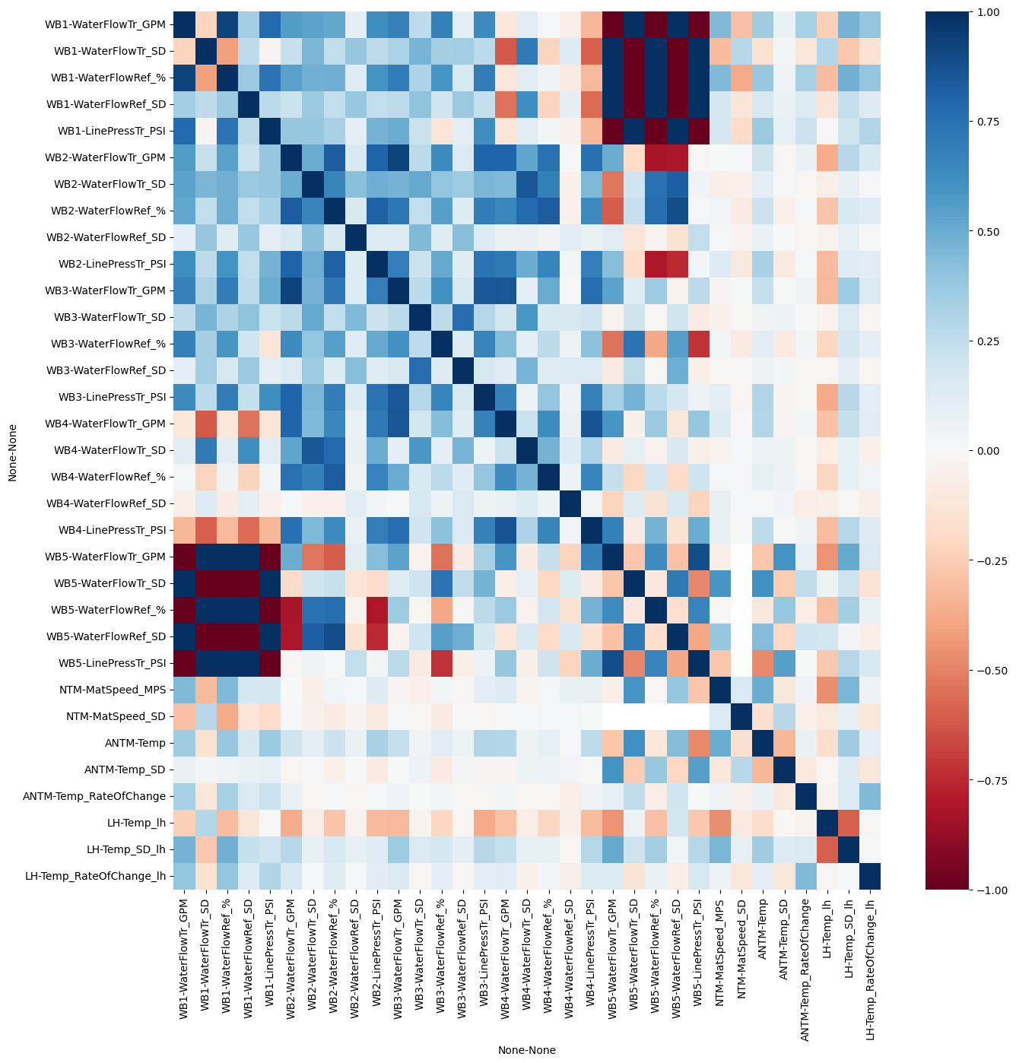
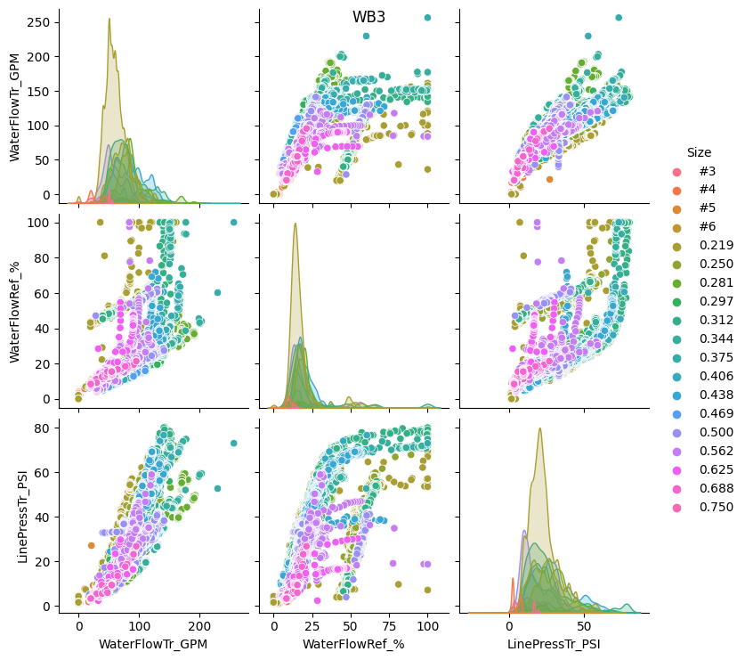
Exploration – Correlations, Pair Plots
Initial correlation, mostly correlated within a waterbox
Pair plots for closer inspection

Slide 8
Factor Reduction
Manual box removal based on little data available
Manual reduction on number of factors
Standard deviations and slopes of raw data trace
Manual limiting to only sizes with similar processing conditions
ML feature reduction
Review via F-test and Mutual information for factor dependencies
Highlighted steps which need to be addressed later (such as extra linear factor)
Conflicting order, decided to keep all factors left from manual determination

Slide 9
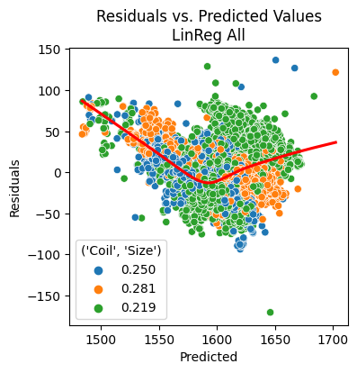
Model Development – Linear Regression
Objective: Develop model to represent final temperature from selected factors
Select train and test data sets
31.5K training records, 13.5K testing records (include 3 different sizes)
Wrote a wrapper function to explore different models and conditions
Calculates model training and testing score
Calculates mean absolute error, mean square error and root mean square error
Calculate VIF for linear regression models
Generates residuals plot which highlights the three sizes
Output as dictionary for use in master “results” table
Comparison of Linear regression to Ridge Regression
Nearly identical performance
Compared “all factors” to models with fewer factors
Remove total water used
Remove total, valve position (non-linear factor)
Remove total, valve position and pressure
No difference of models when total water removed
Coefficient of determination decreased with additional factors removed
Identified control schemes which should not be pursued further

Slide 10
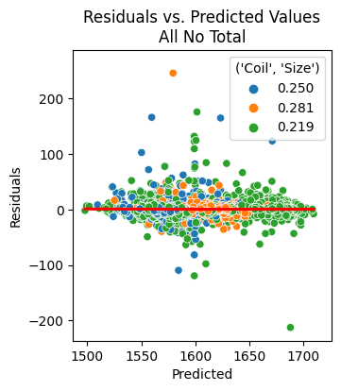
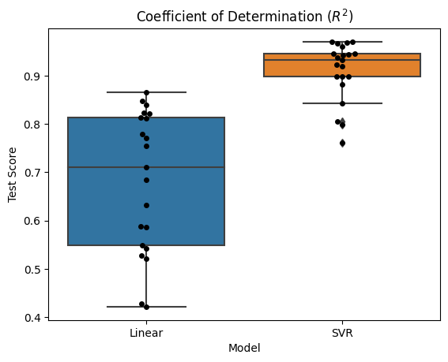
Model Development - Support Vector Regression
Used some insights from Linear Regression to reduce scope
Utilized same wrapper function
Execution of 17 input combinations took 2550 minutes (linear regression was 2 minutes)
Attempted to use muti-threading to better utilize CPU, with no success
SVR model was more representative models
Best predictive model used waterbox 3 & 4 combination

Slide 11
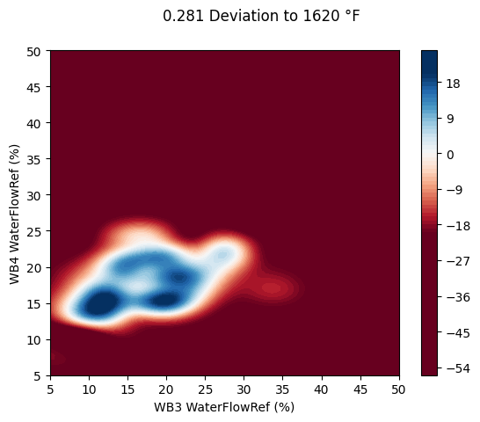
Determination of Optimal settings
Constructed data frame with set points to feed into model
Approximated flow and pressure as linear relationship to valve position
Set incoming speed and temperature to size group median values,
Generated predicted values for input combinations.
Plotted contour curve of valve positions and deviation to set point
Optimal region in white, a non-linear region.

Slide 12
Conclusion
Was able to extract and merge multiple data sources
Accomplished cleaning and factor reduction
Generated models using both Linear and SVR
Evaluated best model for optimal waterbox settings
Future extension
Incorporate more factors and responses
Use improved model for flows and pressures vs valve opening

Slide 13
(719) 299-2412
blakamp@regis.edu

